Slide 1
Road object detection Project in
Selected Topics in computer Science 2
Team #60

Slide 2
Architecture used in the paper THE POPULAR DEEP LEARNING FRAMEWORKS, TENSORFLOW AND CAFFE ARE USED TO TRAIN THE MODELS AS PER OFFICIAL DOCUMENTATION. THE EXPERIMENTAL ENVIRONMENT CONSISTS OF CUDA V10.1, CUDNN V7.6.4, OPENCV V4.5.0, UBUNTU 18.04.5 OS, 16 GB RAM, INTEL I7-8750H CPU, AND NVIDIA GEFORCE RTX 2080 TI GPU. THE AUGMENTATION IS APPLIED TO TRAINING AND VALIDATION IMAGES TO INCREASE THE LEARNING ABILITY. THEREFORE, THE OPTIMAL BATCH SIZES OF 2 (FOR MASK-RCNN), 4 (FOR R-FCN AND RETINANET), AND 8 (FOR SSD AND YOLOV4) ARE USED TO SPEED UP THIS EVALUATION. THE STOCHASTIC GRADIENT DESCENT (SGD) IS USED AS AN OPTIMIZER DURING TRAINING. THE INITIAL VALUE OF THE LEARNING RATE IS SET TO 0.1, THE MOMENTUM RATE IS SET TO 0.949, AND THE DECAY RATE IS SET TO 0.0001 TO REDUCE TRAINING LOSS AND PREVENT GRADIENT EXPLOSION. THE LEARNING RATE IS REDUCED BY 0.5 AT EVERY 50TH EPOCH. NO OTHER PARAMETERS WERE MODIFIED AND TAKEN AS DEFAULT BY THE FRAMEWORKS. THE TRAINING LASTED FOR 200 EPOCHS. AFTER TRAINING, THE NETWORK WEIGHTS ARE OBTAINED TO TEST THE EXPERIMENTAL RESULTS ON IMAGES FROM BDD100K TEST DATASET.
The Two-stage object detection models used:
The Region-based Fully Convolutional Networks (R-FCN) algorithm.
The Mask Region-based Convolutional Neural Networks (Mask R-CNN) algorithm.
The One-stage object detection algorithms used:
A Single Shot MultiBox Detector (SSD) model.
A RetinaNet model.
The You Only Look Once (YOLO) algorithms..
NOTE: We tried to implement the Yolo-v4 algorithm for the project.

Slide 3
DATASET DETAILS A KAGGLE DATASET by SAKSHAM JAIN VEHICLE DETECTION 8 CLASSES | OBJECT DETECTION A DATASET FOR OBJECT DETECTION FOR DIFFERENT TYPES OF VEHICLES WITH 8 CATEGORIES Link to the dataset: https://www.kaggle.com/datasets/sakshamjn/vehicle-detection-8-classes-object-detection
About Dataset
For analyzing the traffic over road, images with Boundary-Box annotations.
This dataset, contains images with bounding box annotations in the PASCAL VOC format for these 8 classes:
Motorcycle Auto Car Bus LCV(Light Motor Vehicle) Truck Tractor Multi-Axle

Slide 4


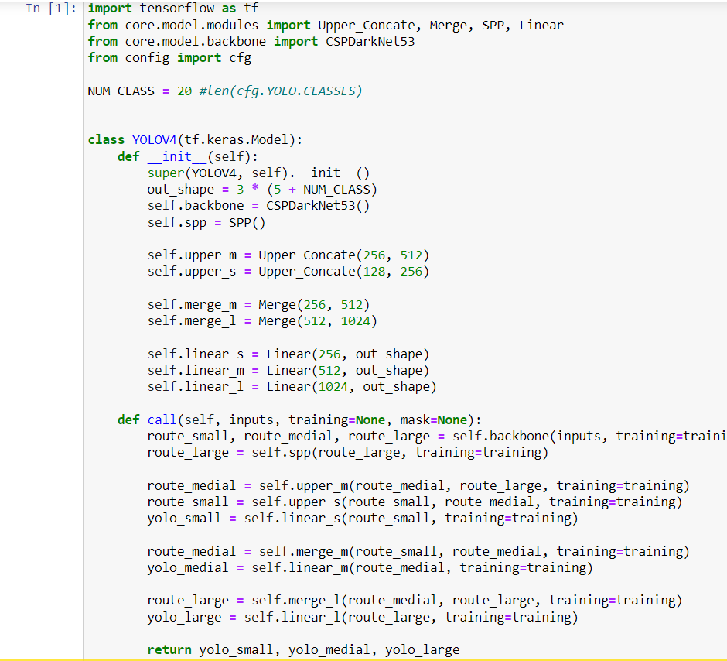
Implementation details
@article{mahaur2022road,
title={Road object detection: a comparative study of deep learning-based algorithms},
author={Mahaur, Bharat and others},
journal={Multimedia Tools and Applications},
pages={1--36},
year={2022},
publisher={Springer}
}

Slide 5
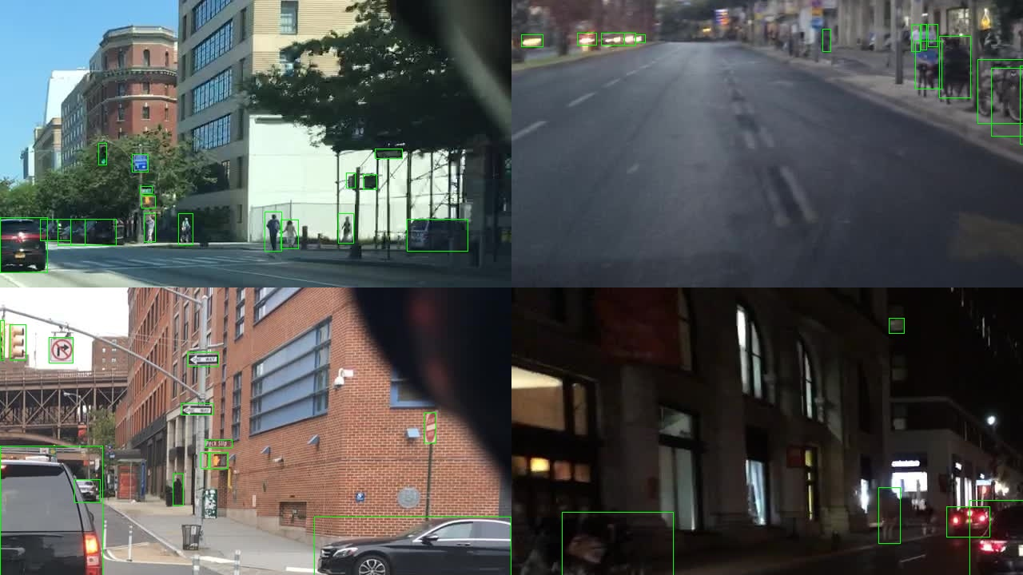
RESULTS
Thank You!

